Slide 1
Digital finance & Blockchain Technology
Motivation, Components, and Core Concepts

Slide 2
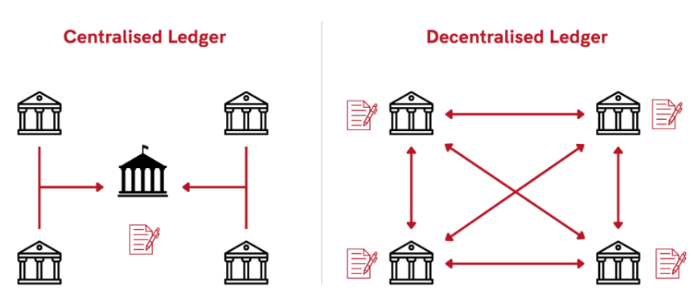
Motivation Behind Blockchain

Slide 3
Motivation Behind Blockchain
Lack of trust in centralized systems
Need for transparency and immutability
Reducing intermediaries in transactions
Secure peer-to-peer value transfer
Resistance to fraud and data tampering

Slide 4
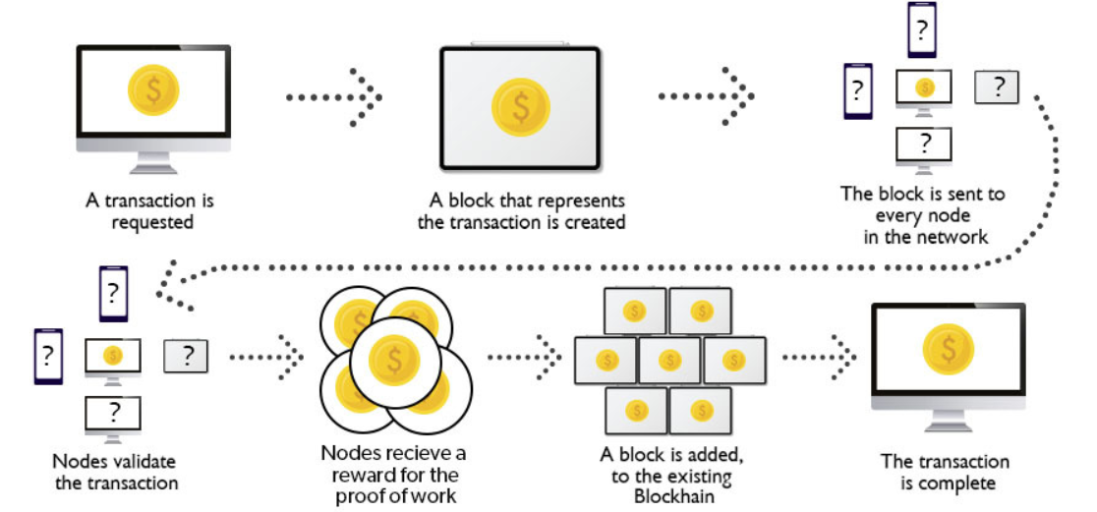
Overview of Blockchain

Slide 5
Overview of Blockchain
Distributed and decentralized digital ledger
Records transactions in blocks
Blocks are linked using cryptography
Maintained by a network of nodes
Data once added cannot be easily altered

Slide 6
Components of Blockchain
Digital Signatures
Hashing
Consensus Mechanism
Distributed Ledger
Network Nodes

Slide 7
Digital Signatures
Use public key cryptography
Utilizes both private and public key
Ensure authentication and non-repudiation
Verify the sender of a transaction
Commonly implemented using RSA or ECDSA

Slide 8
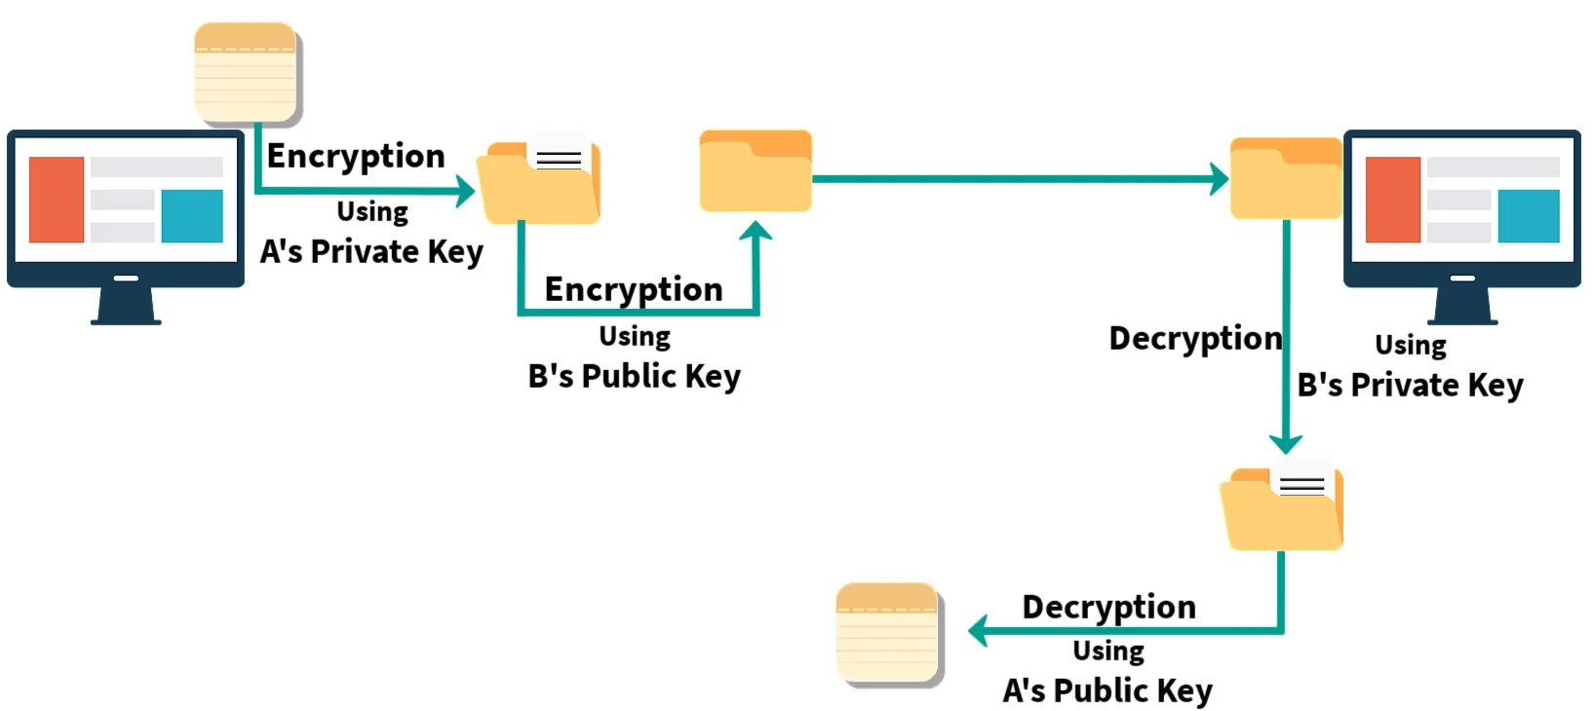
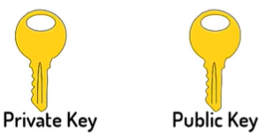
Digital Signatures

Slide 9
Hashing
Converts input data into fixed-size output
One-way and collision-resistant
Links blocks securely
Common hash function: SHA-256

Slide 10
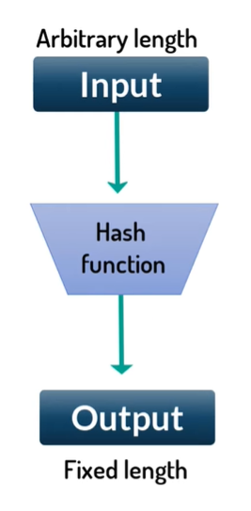
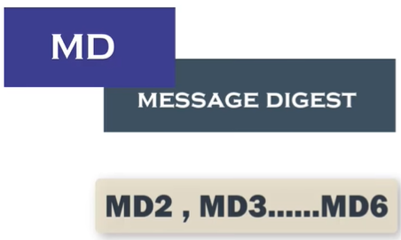



Hashing

Slide 11
Consensus Mechanism
Process by which nodes agree on ledger state
Prevents double spending
Maintains network security
Examples: Proof of Work, Proof of Stake

Slide 12
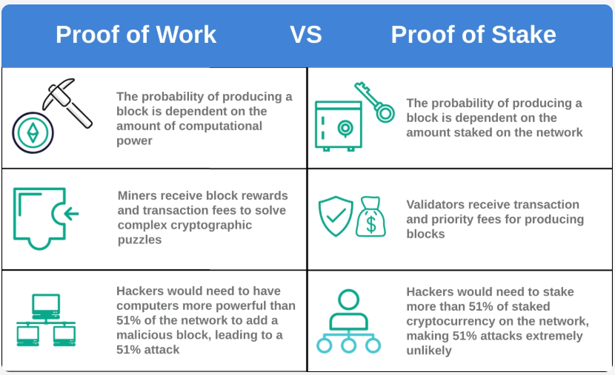
Consensus Mechanism

Slide 13
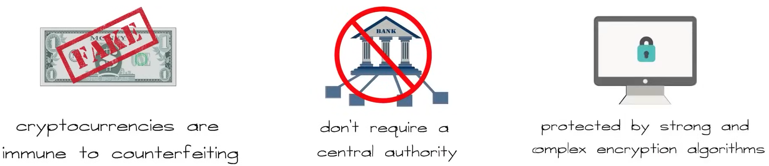
Cryptocurrency (Overview)
Digital or virtual currency
Uses cryptography for security
Operates without central authority
Examples: Bitcoin, Ethereum

Slide 14
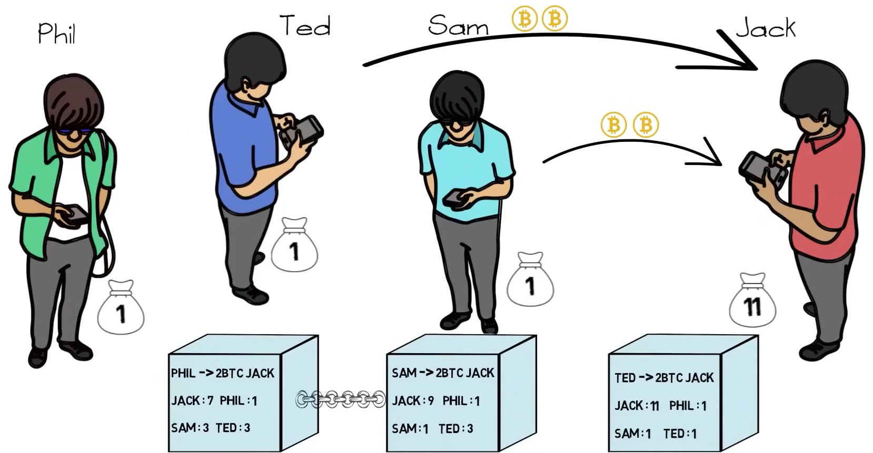
Cryptocurrency (Overview)

Slide 15
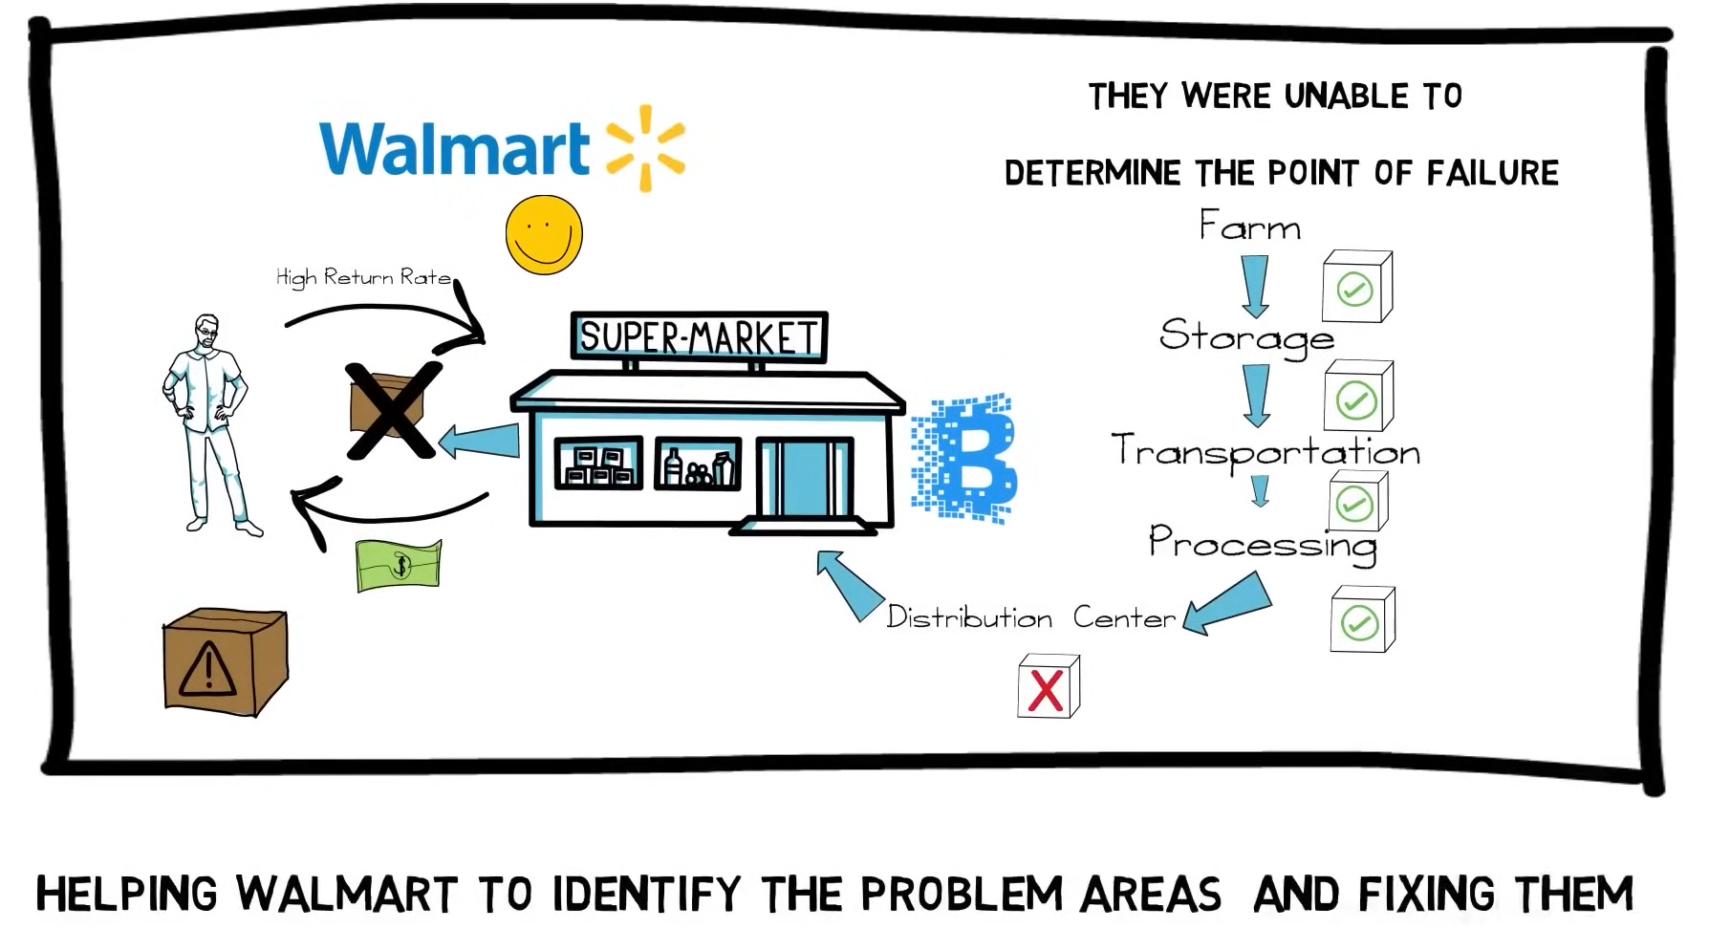
Cryptocurrency (Overview)

Slide 16
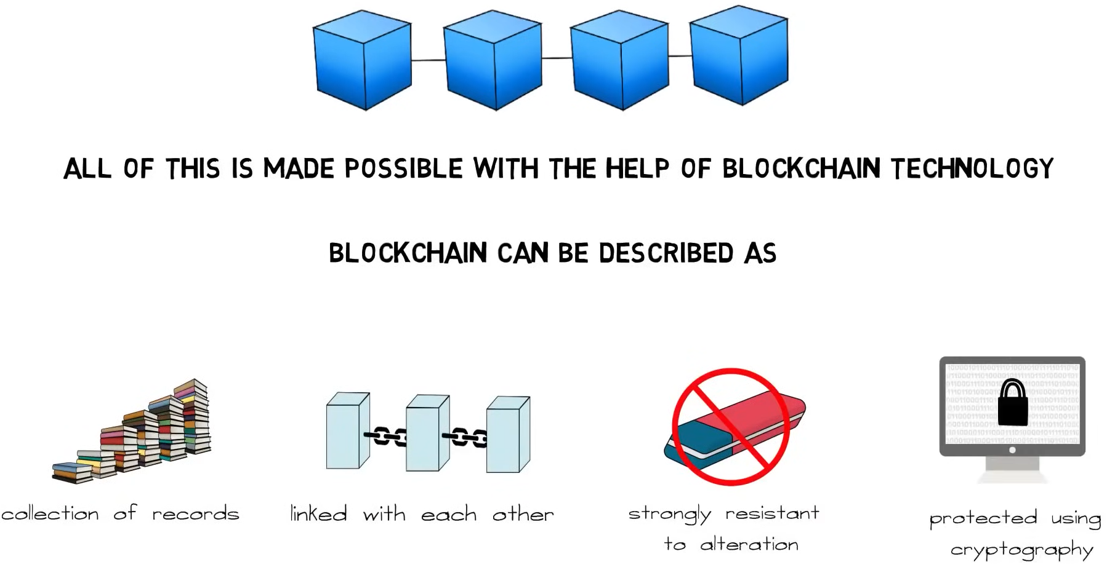
Cryptocurrency (Overview)

Slide 17
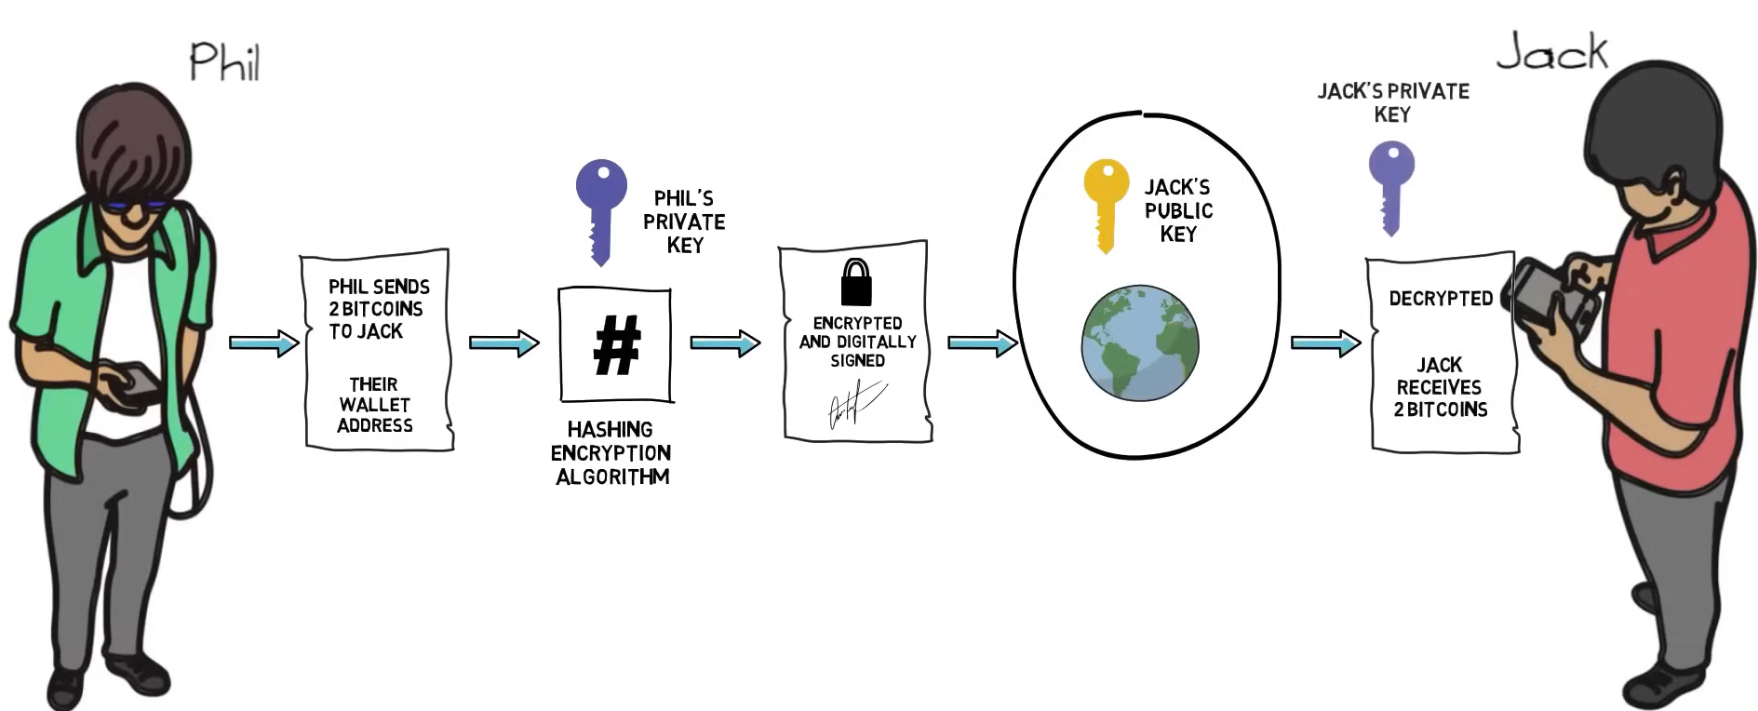
Cryptocurrency (Overview)

Slide 18
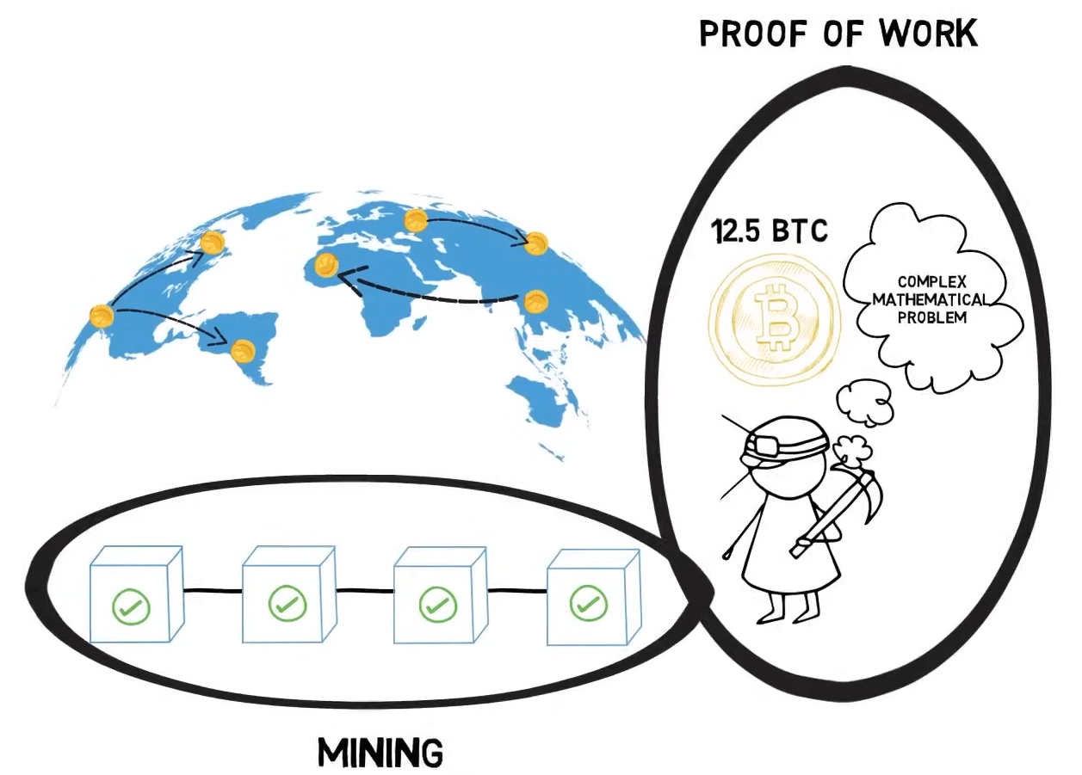
Cryptocurrency (Overview)

Slide 19
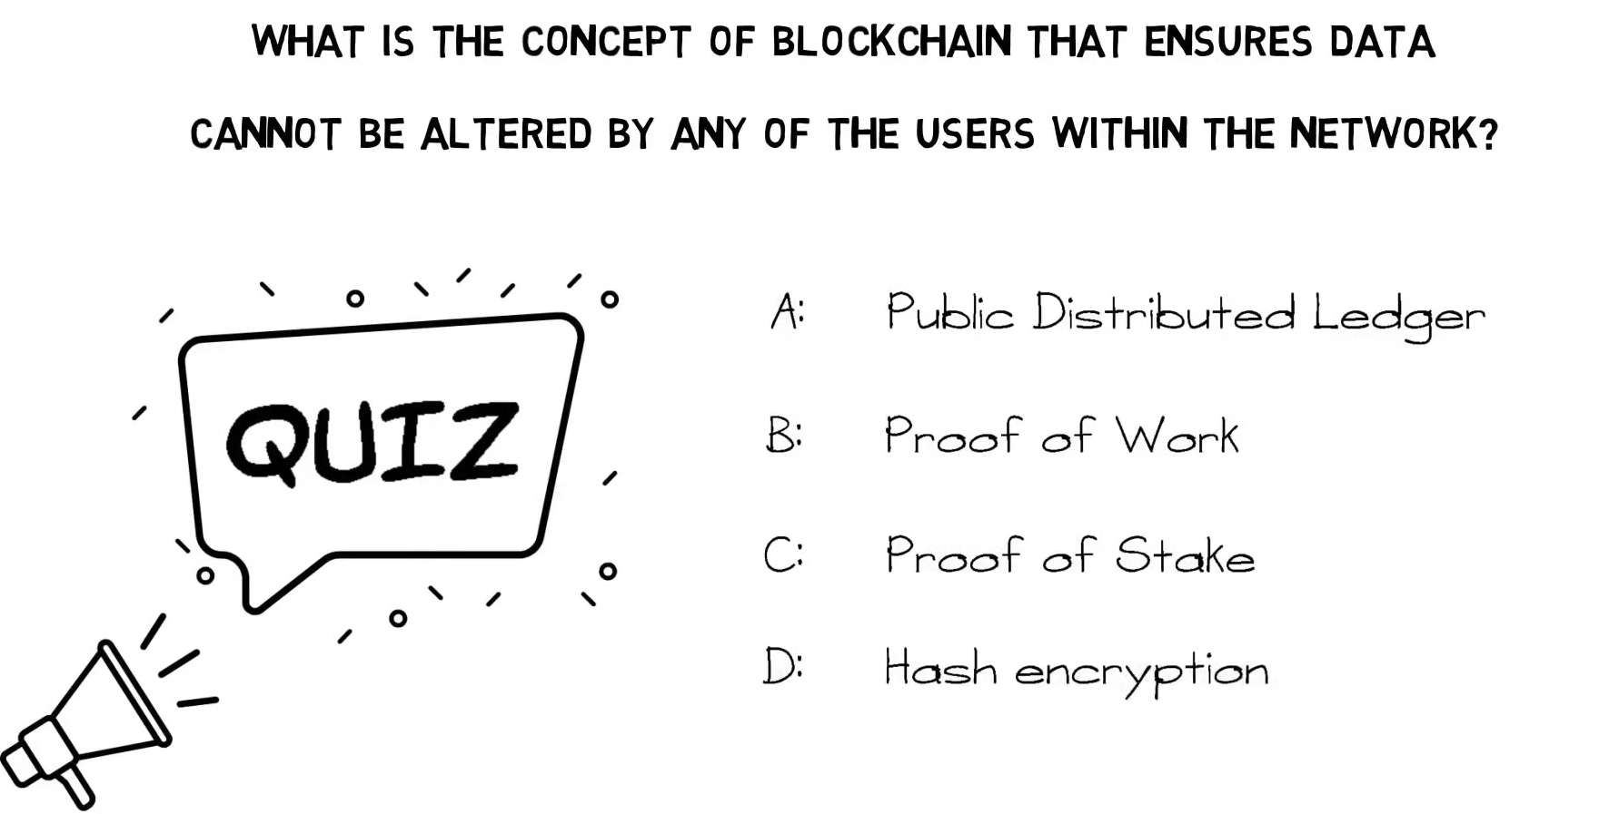

Slide 20
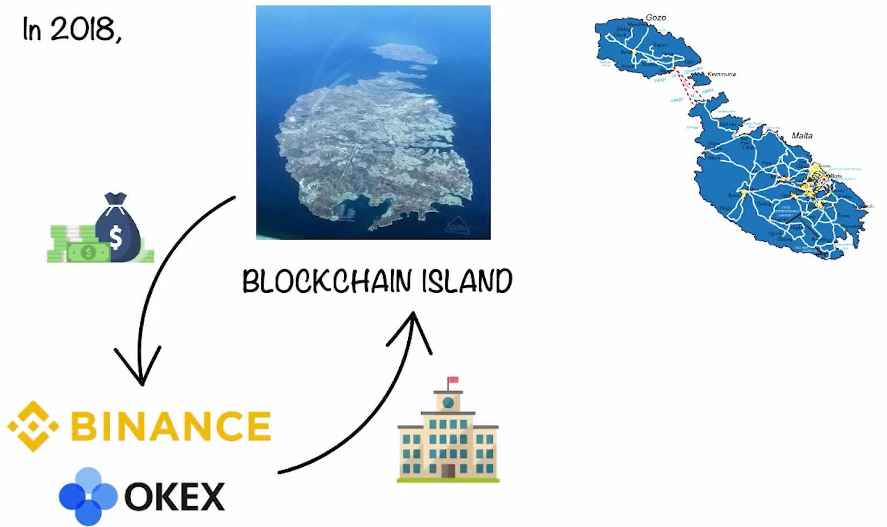
Cryptocurrency (Overview)

Slide 21
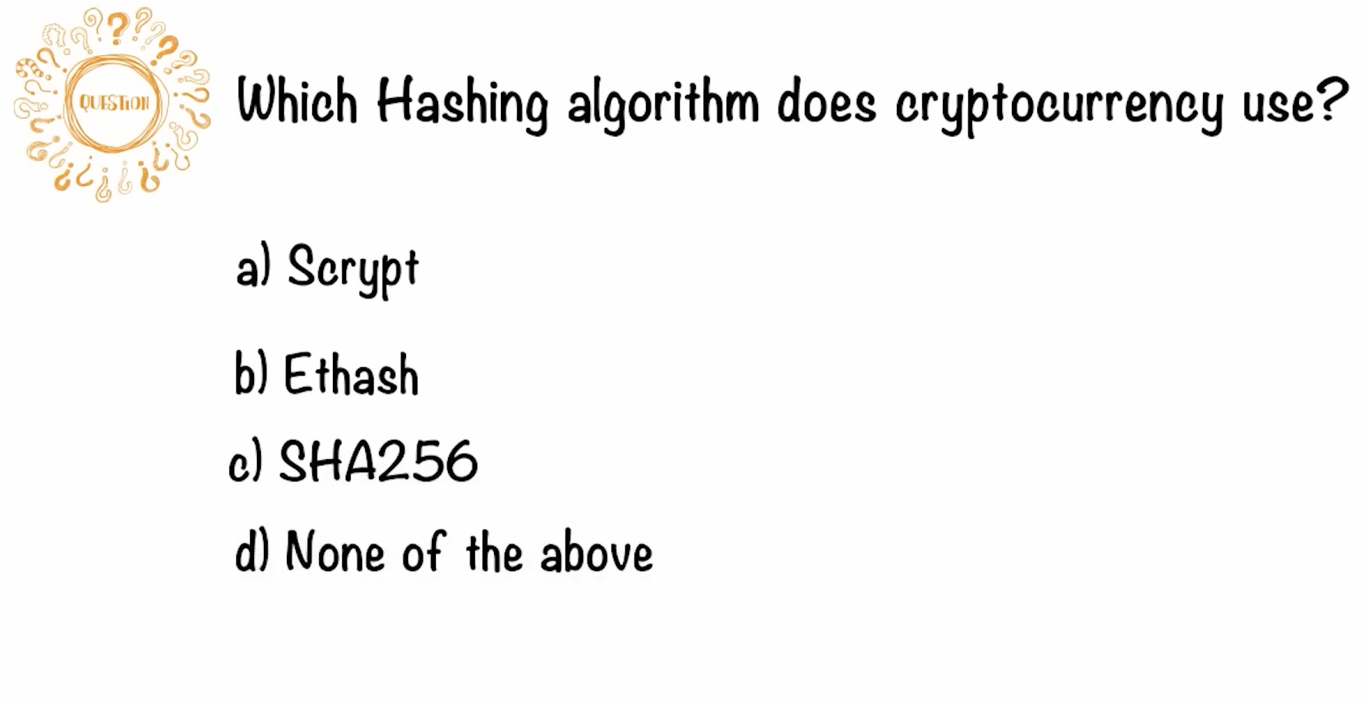

Slide 22
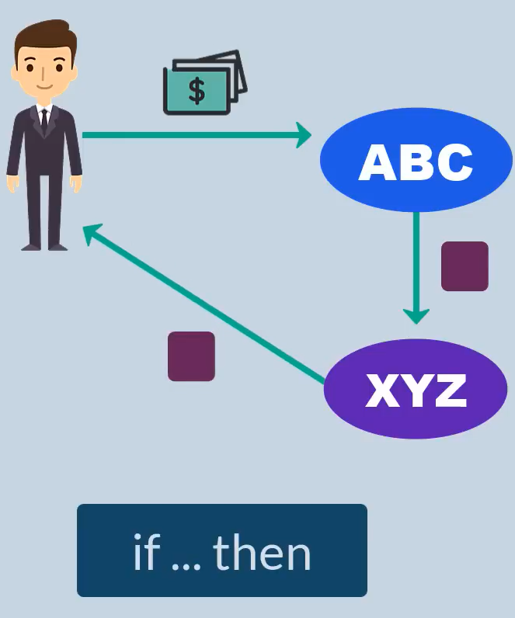
Smart Contracts (Overview)
Self-executing contracts with coded rules
Automatically enforce agreements
Run on blockchain platforms like Ethereum
Reduce need for intermediaries

Slide 23
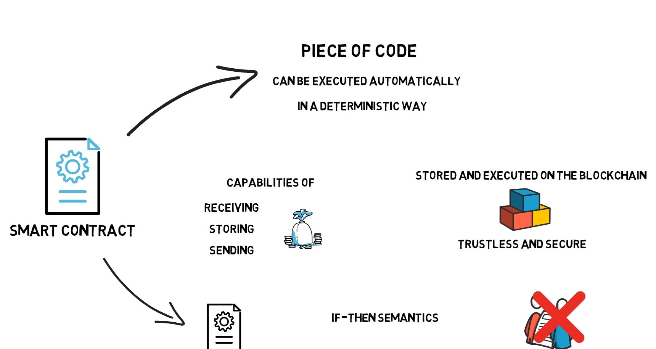
Smart Contracts (Overview)

Slide 24
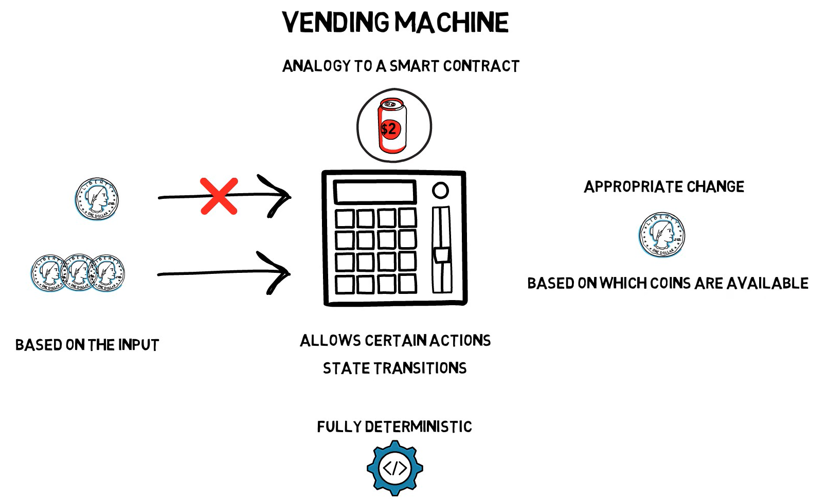
Smart Contracts (Overview)

Slide 25
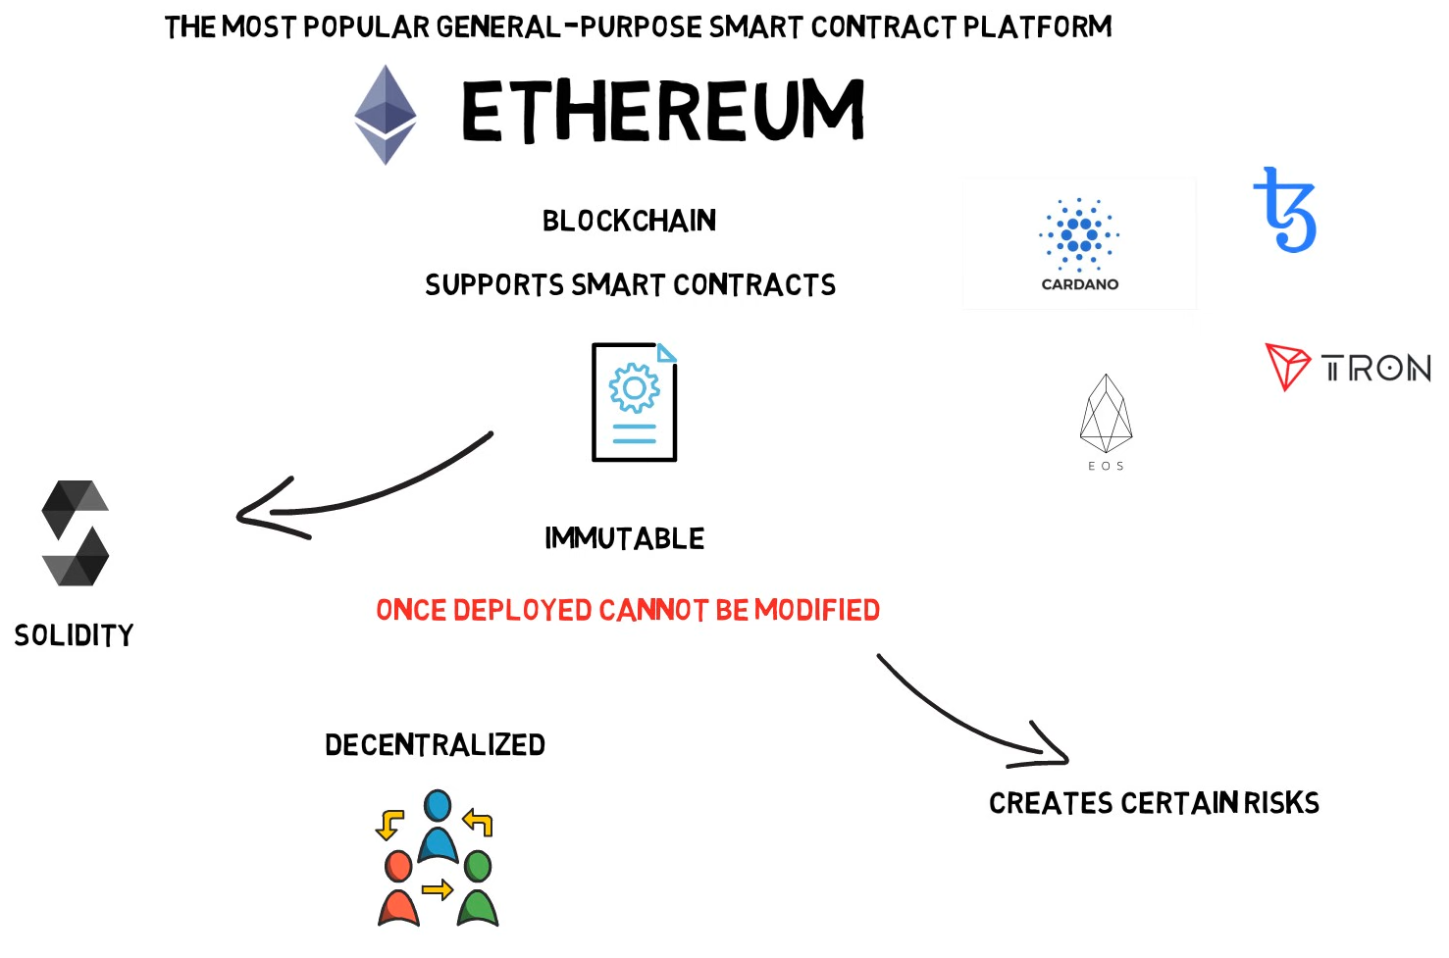
Smart Contracts (Overview)

Slide 26
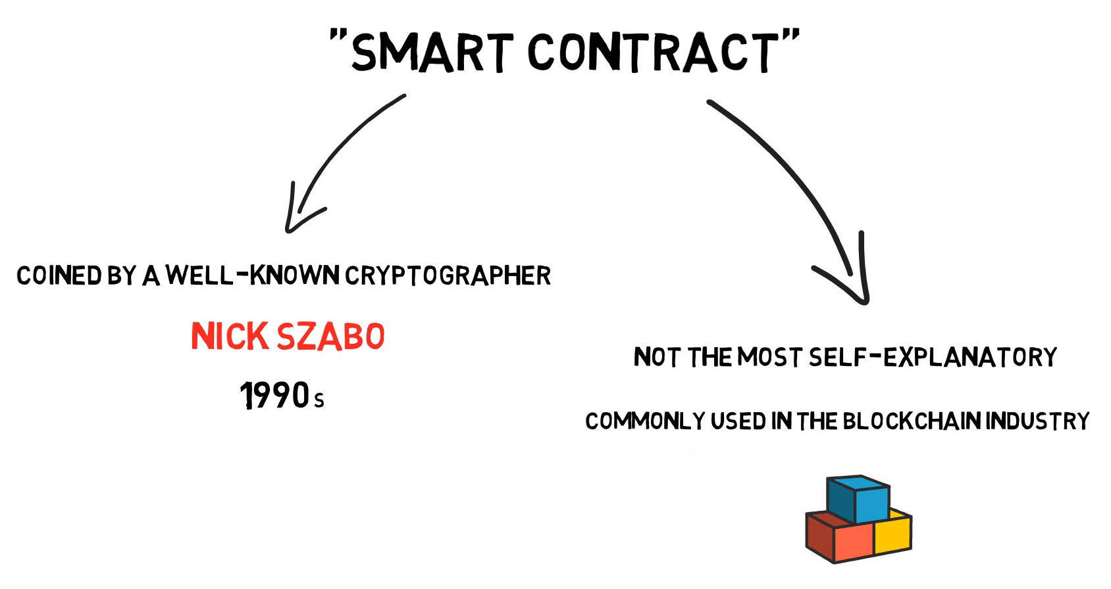
Smart Contracts (Overview)

Slide 27
Smart Contracts (Overview)

Slide 28
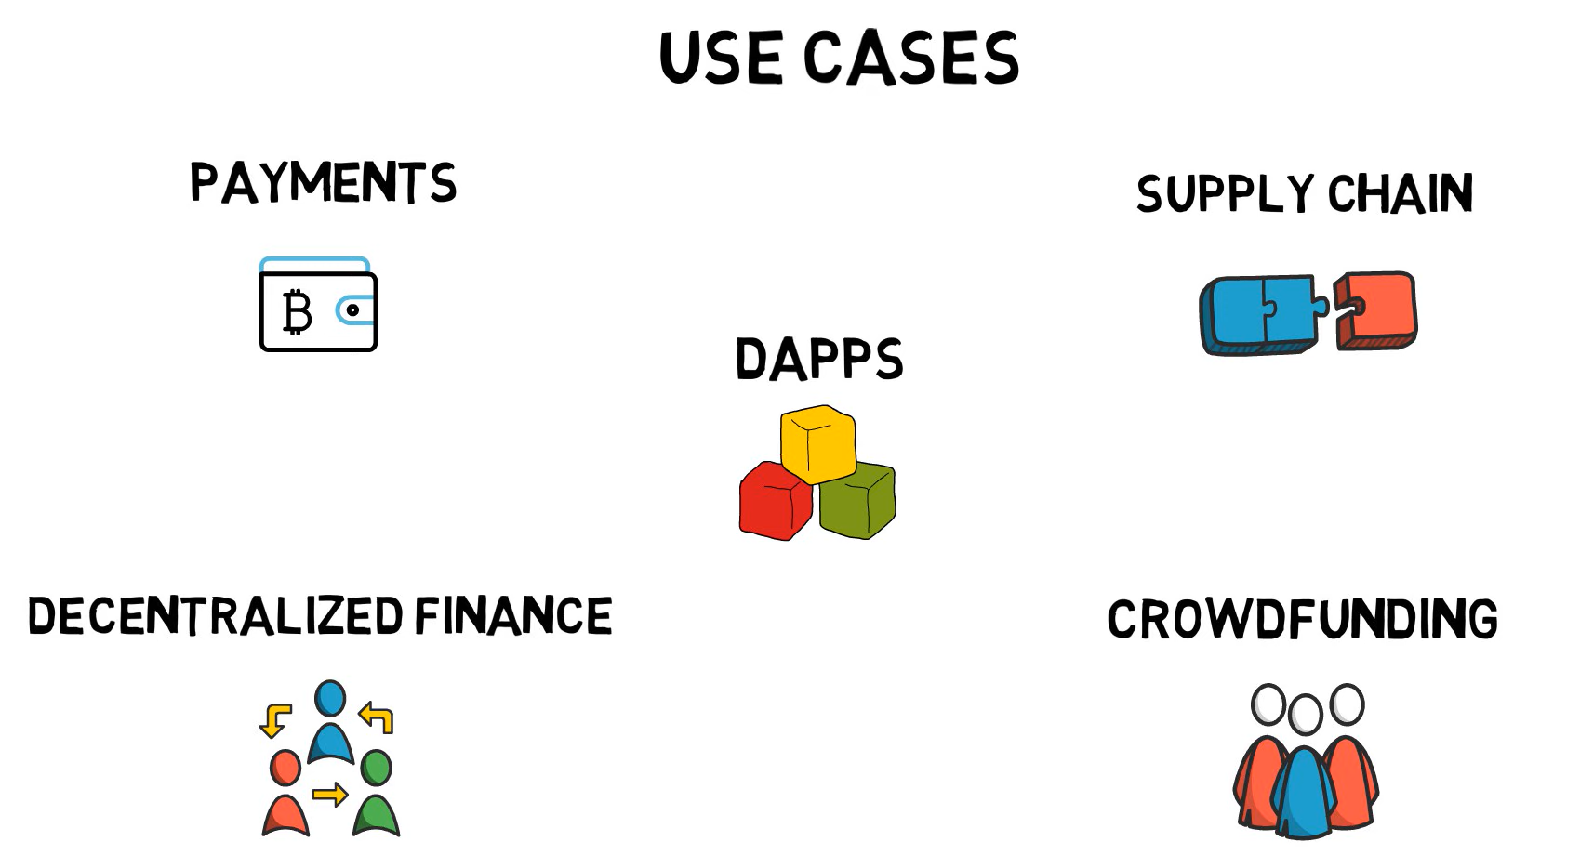
Smart Contracts (Overview)

Slide 29
Smart Contracts (Overview)

Slide 30
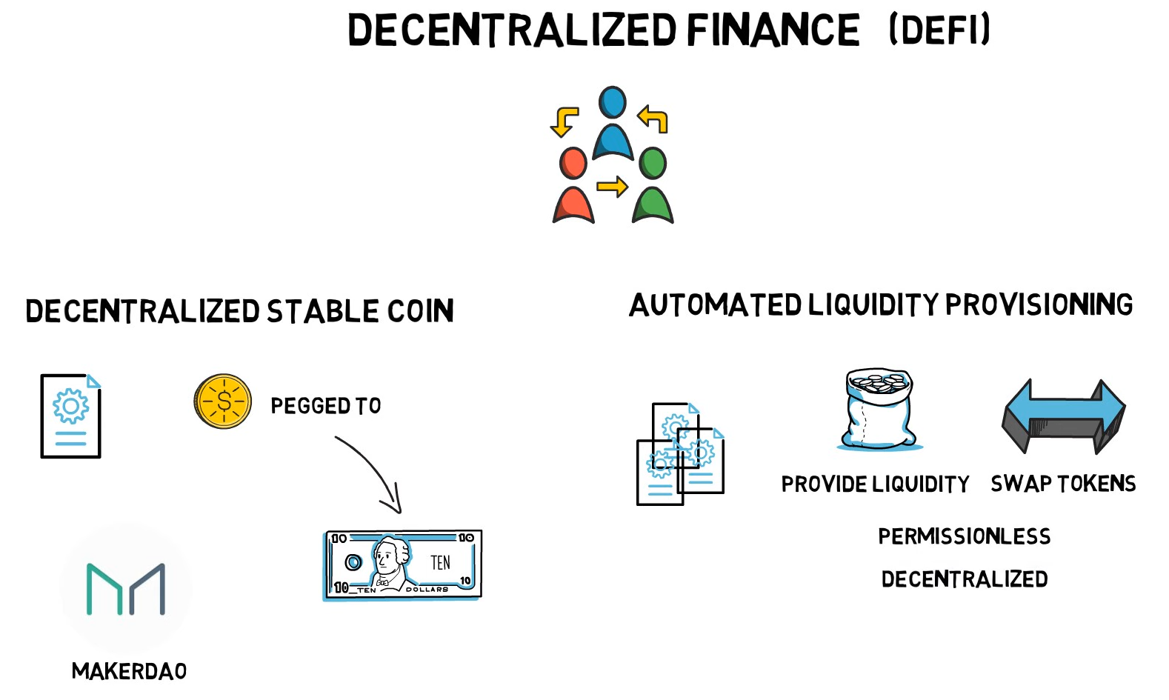
Smart Contracts (Overview)

Slide 31
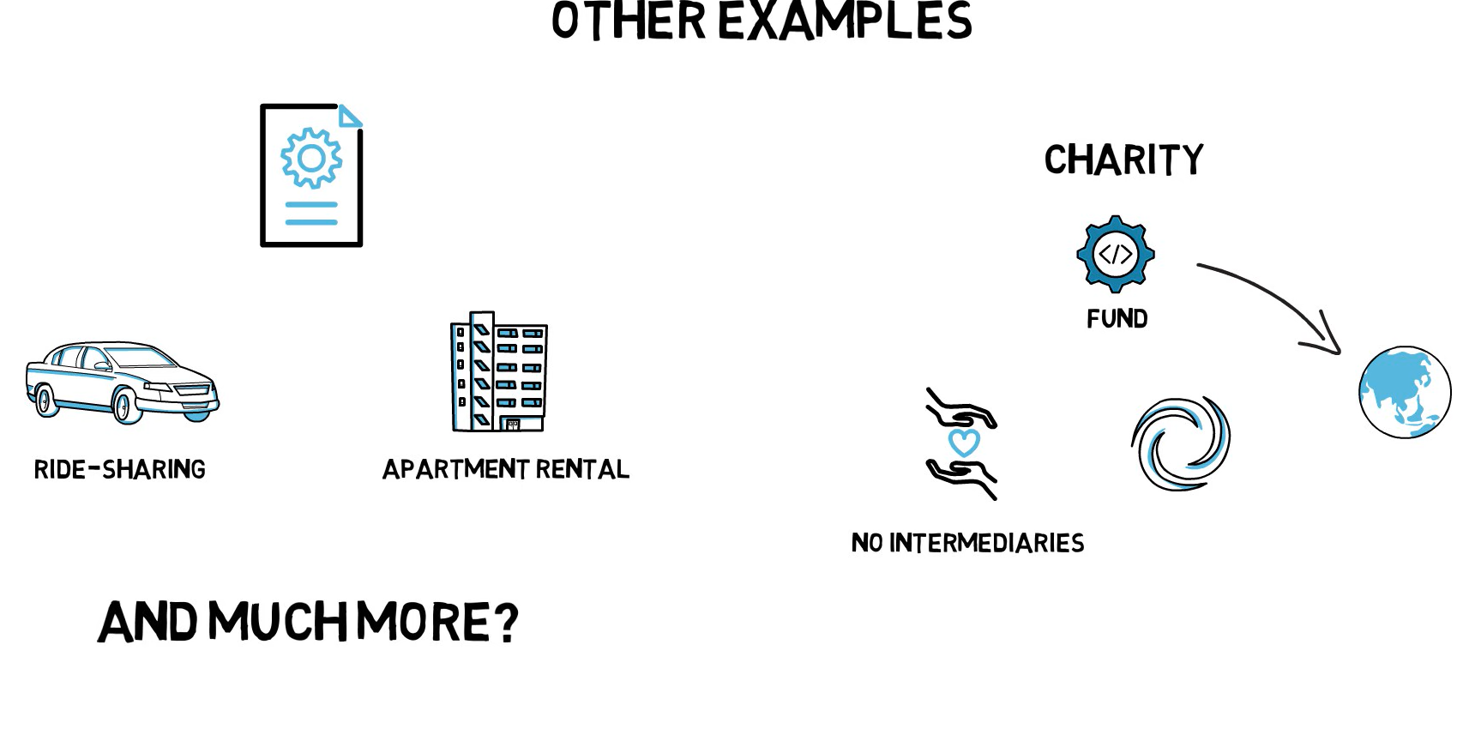
Smart Contracts (Overview)

Slide 32
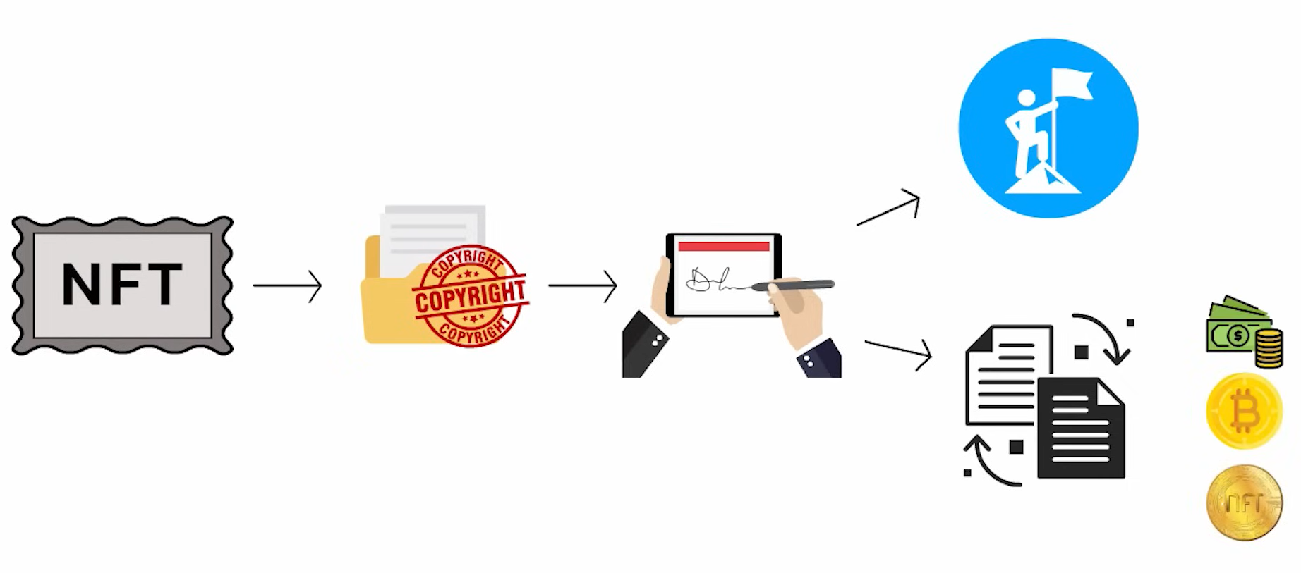
Non-Fungible Tokens (NFTs)
Unique digital assets on blockchain
Represent ownership of digital or physical items
Not interchangeable like cryptocurrencies
Used in art, gaming, music, and collectibles

